Slide 1
2025 Nevada Transportation Conference
Nevada’s Wildlife Crossings
Presenter: Jozo Vujeva
Co-author: Glen Church
05/14/2025

Slide 2
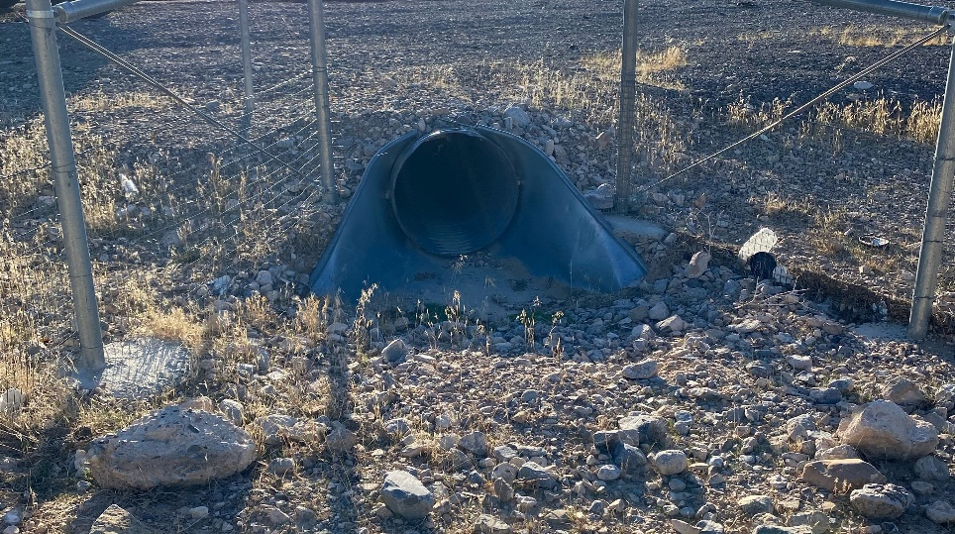
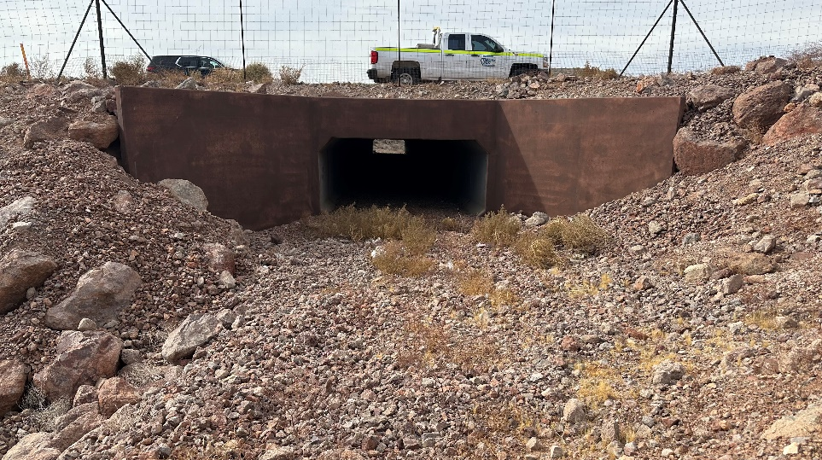
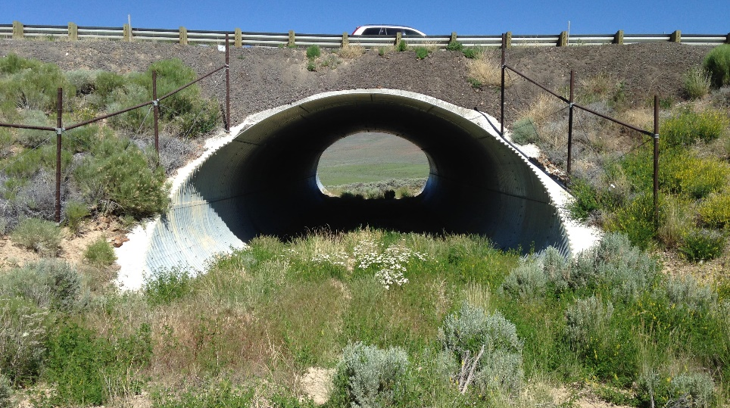
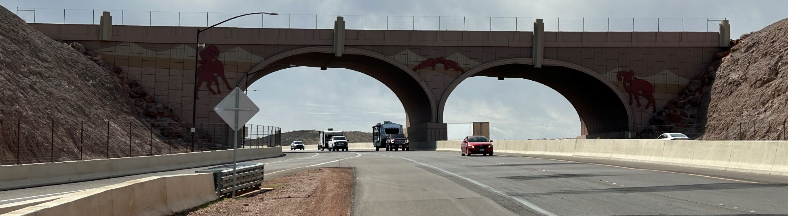
Wildlife Crossings
Types of wildlife crossings in Nevada
Overpass/Land Bridge
Underpass/Tunnel
Reinforced Concrete Box (RCB) Culverts
Corrugated Metal Pipe (CMP) Culverts

Slide 3
Wildlife Crossings
Overpass/Land Bridge
Multiple species accessible
Underpass Tunnel
RCB and CMP culvert conversions
Provides connectivity for other species such as kitfoxes, coyotes, badgers, and reptiles, such as the Mojave desert tortoise
Overpass/Land Bridges allow for the movement of wildlife across transportation networks that transect their habitat.
Focused on larger wildlife species
Accessible to a broader range of species
Caters to both large and small species who may prefer concealment
Reduces fragmentation of habitat

Slide 4
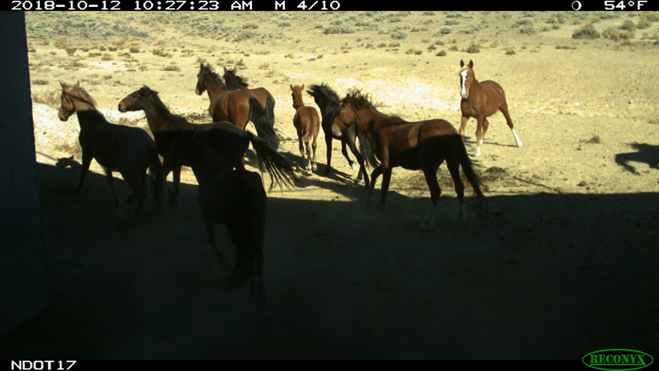
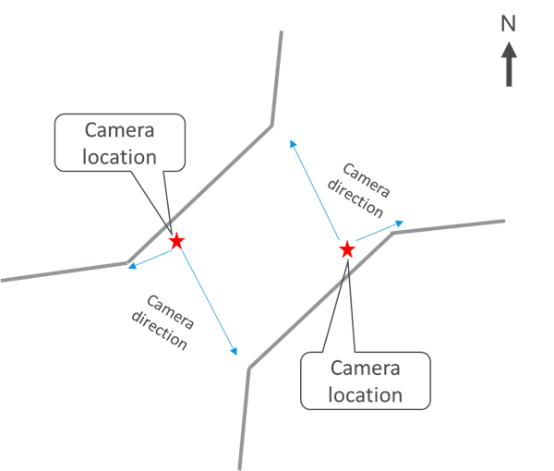
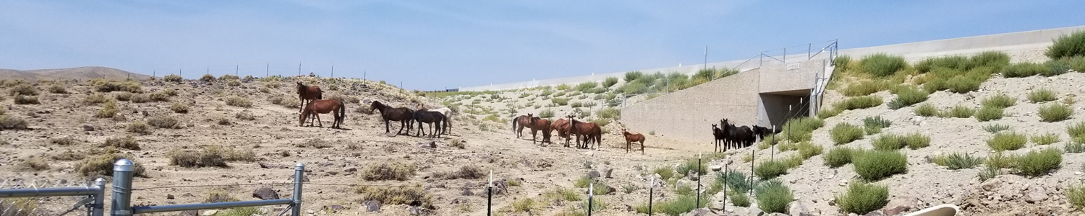
US 50 Dayton and USA Parkway
Notes:
2013 – first underpass outside of Dayton for feral horses - UNR study to look at behavioral acceptance
Successful, so we were able to add two more to the USA Parkway extension
Fencing combined with structures helps prevent horse-vehicle collisions
Horses are the most dangerous animals in Nevada (long legs and high center of gravity – fall into the car or people swerve).

Slide 5
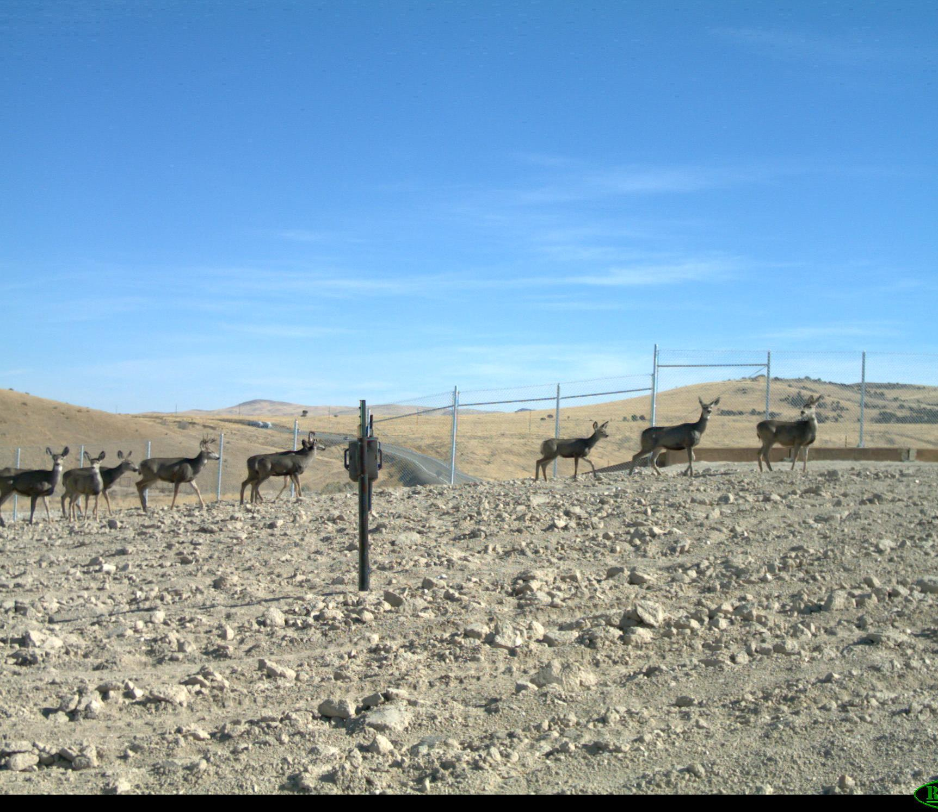
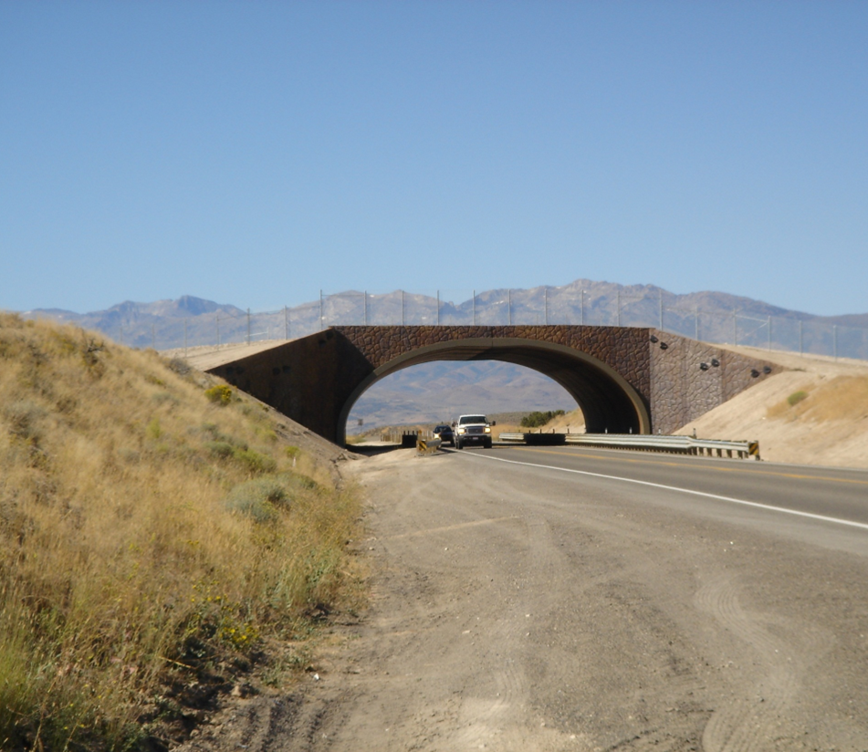
Northern Nevada Crossings on I-80 and US-93
Notes:
US 93 north of Wells – 2010, first crossings in Nevada
I-80 – 2013 first overpass along an interstate in Nevada – Silver Zone Pass.
2018 – Pequop Summit along I-80 –two more overpasses – biggest problem area for the state with 70-80 collisions happening during each migration, but it was also our most expensive project. Now we get only a few reports each year.

Slide 6
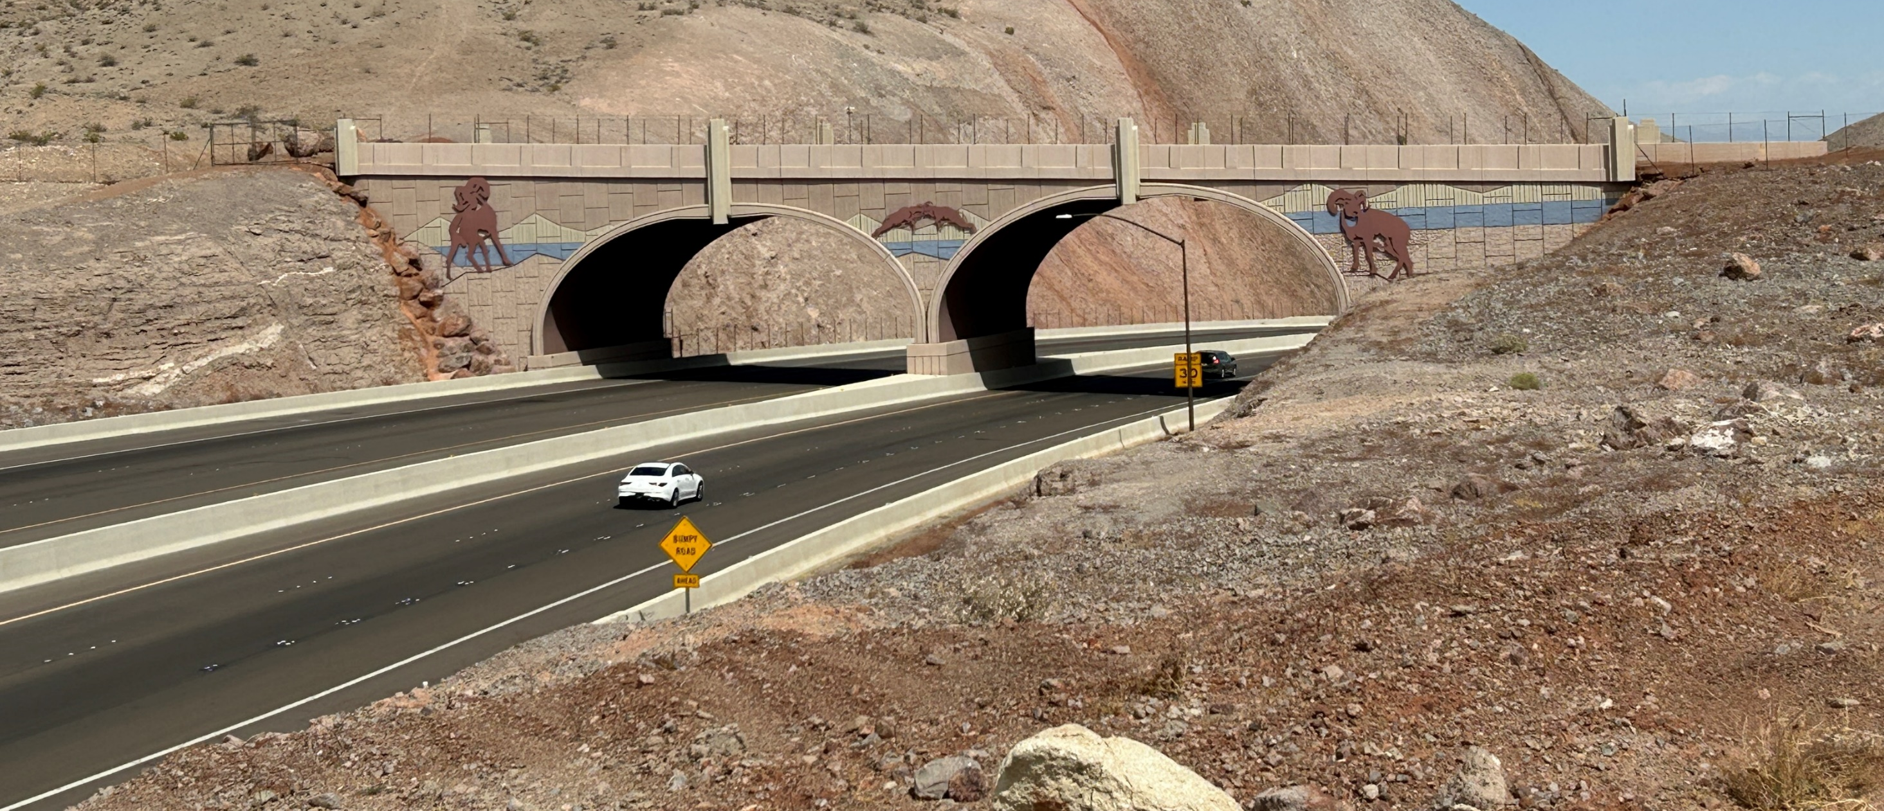
Southern Nevada Wildlife Crossings-Boulder City Bypass I-11
Notes:
Boulder City Bypass – first structure that focused on bighorn sheep in Nevada. 2018 $1.6 million.
Several large bridges which also serve as underpasses. Sheep have been documented using the bridges more and use it for shade.

Slide 7
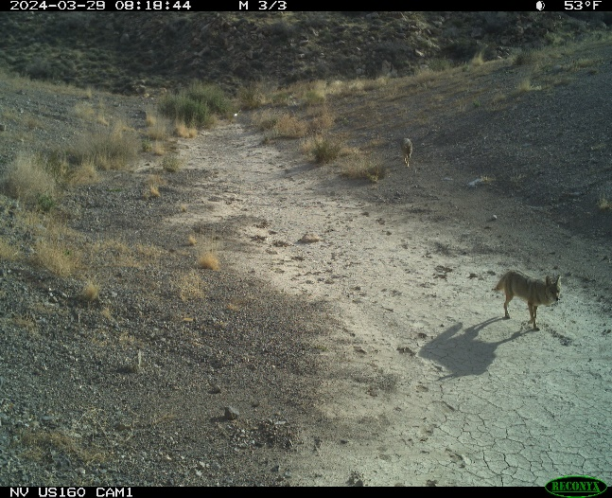
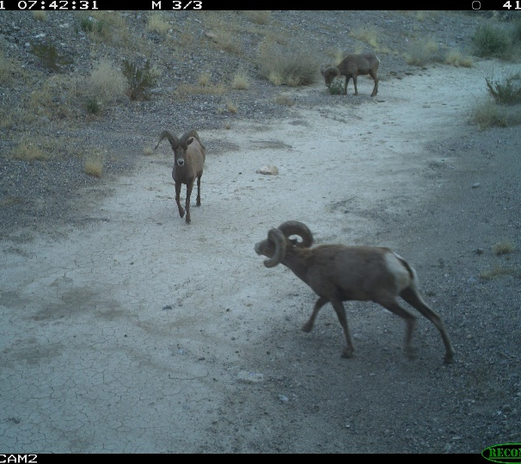
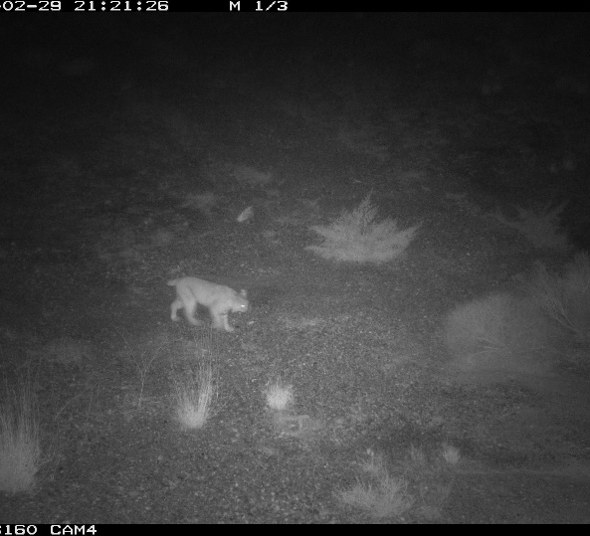
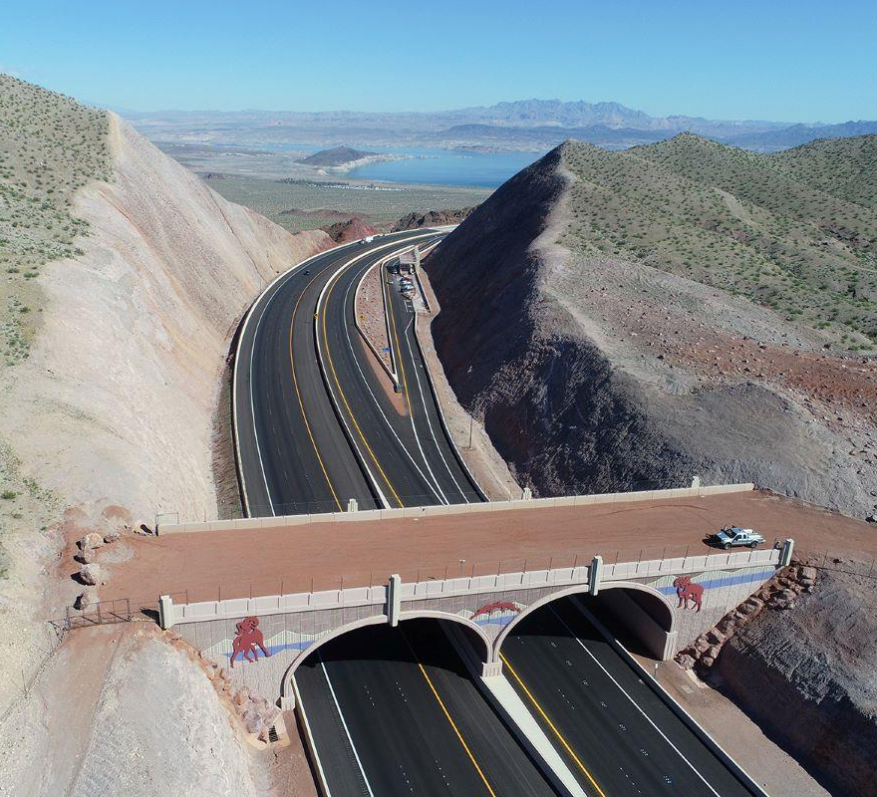
Southern Nevada Overpass/Land Bridge & Underpasses
I-11 Overpass connects grazing and lambing regions for Big Horn Sheep
SR 160 Underpass allows for multiple species to range from one side of the pass to the other
Notes:
Overpass/Land Bridges and underpasses allow for the movement of wildlife across transportation networks that transect habitat.
Bighorn sheep, wild horses, deer, and predators such as the bobcat, coyote, and mountain lion all utilize these structures and pass unnoticed by motorists.
These structures tend to focus on large mammals and do little to serve the needs of most reptiles, including the federally protected Threatened Mojave desert tortoise.
Tortoises require cover to move from location to location as they travel through their home range.

Slide 8
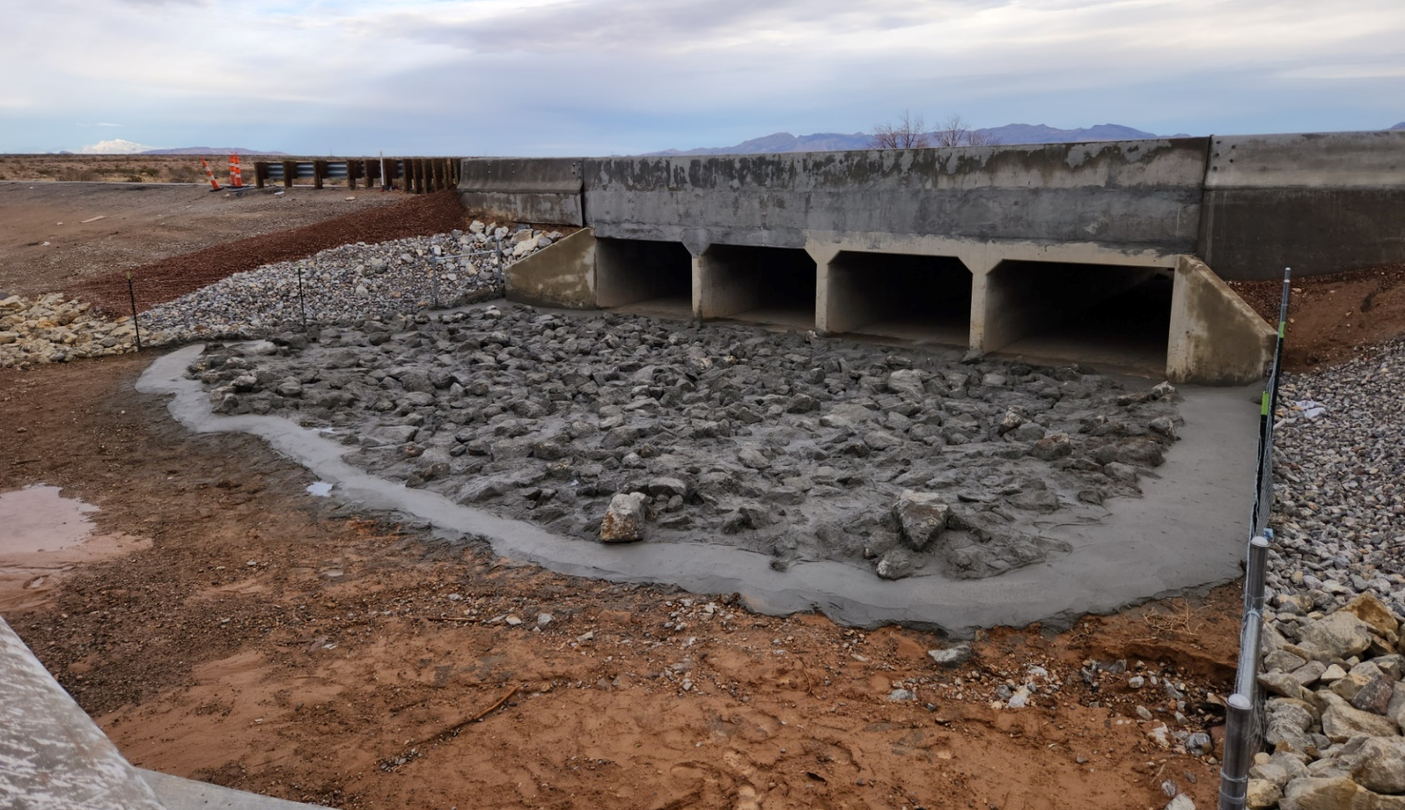
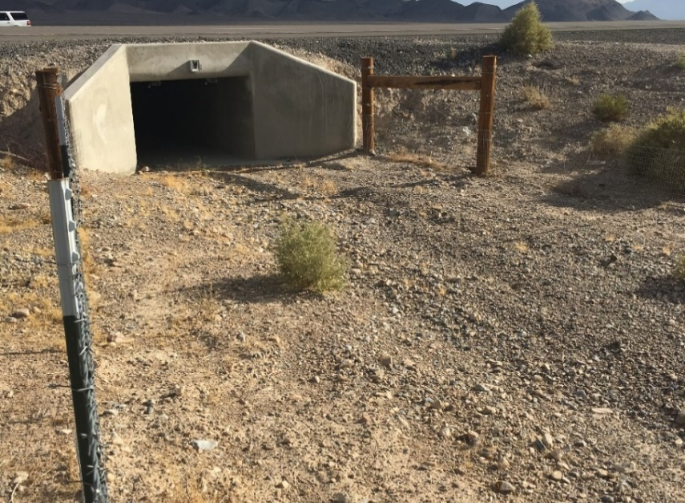
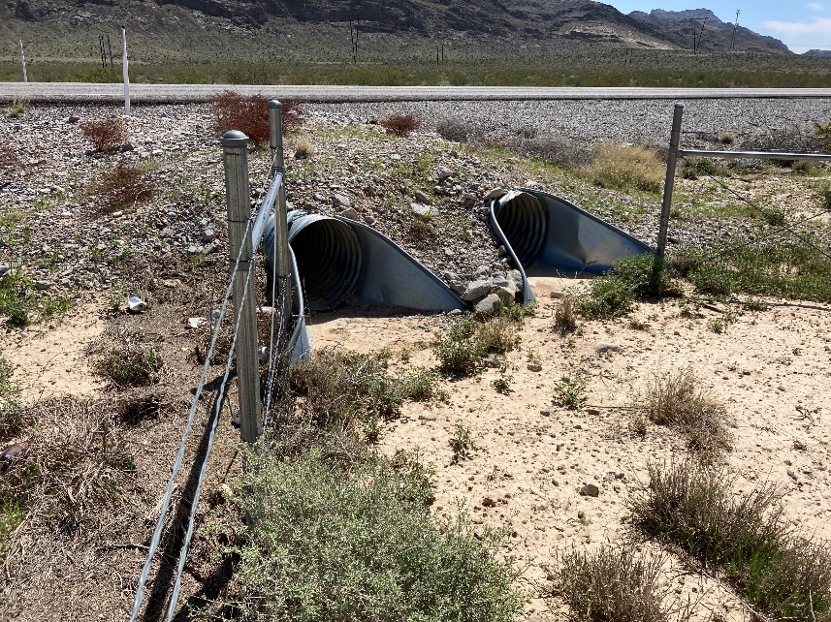
Southern Nevada RCB & CMP Culverts
Conversion of existing culvert structures Interstate 15
Addition of tortoise fence funnels on US 93 and US 95
Unique to Southern Nevada
Designed specifically for the Mojave desert tortoise
Notes:
Culverts can provide the necessary covered passage the desert tortoise needs.
In conjunction with desert tortoise exclusionary fencing, tortoises and other wildlife can be funneled to these culvert, allowing for safe passage.
Other wildlife, including nocturnal species who prefer cryptic movement patterns, also utilize culverts to safely range from one side of the highway to the next.
Conversion of RCB and CMP culvert structures to wildlife crossings greatly reduces the dead zone effect typically observed along our highways and state routes.
Dead zones can extend as much as 600 feet from the edge of the shoulder.

Slide 9
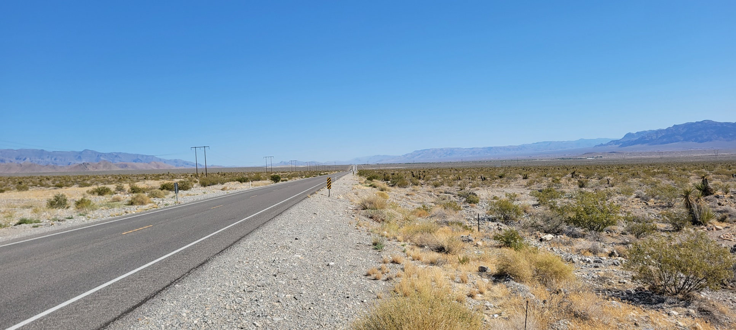
Coyote Springs Wildlife Crossings Project
NDOT has been selected to receive a $16.8 million Grant under the FHWA Wildlife Crossing Pilot Program
Project is located along US 93 in Clark and Lincoln Counties covering approximately 34 miles of highway
Modification of 61 culverts to create wildlife crossings and the installation of 68 total miles of desert tortoise exclusionary fencing on both sides of US 93
Designated critical habitat and bisects the Coyote Springs Desert Wildlife Management Area (DWMA)
Notes:
Numerous partners participated in the pursuit of this grant. Clark & Lincoln Counties, Coyote Springs Investment LLC (private company owning the Coyote Springs development area and golf courses – KEY member as they are providing in-kind assistance), Desert Research Institute, USFWS Las Vegas and Palm Springs offices, BLM Las Vegas, multiple biological and environmental consulting firms, and NDOT
In other words, a very large group of interests got together to apply for and eventually acquire this grant.

Slide 10
US 93 and Coyote Springs DWMA
Desert National Wildlife Refuge (DNWR)
Coyote Springs Investment (private development)
Coyote Springs Area of Critical Environmental Concern (ACEC)
Last desert tortoise critical habitat that is unfenced in Southern Nevada
Notes:
These element make up the DWMA. It is prime habitat that has seen not only the normal loss of juveniles by as high as 99%, but also has seen significant loss of adults.
The loss of adults for recruitment is the key driver of the collapse of the tortoise populations in this valley. Too many adults are being hit by motor vehicles.
The placement of the highway almost perfectly bisects the habitat in the region, amplifying the devastation of the mortality rate.
The magnitude of the slaughter/loss is truly unknown due to the rapid removal of carcasses by carrion eaters.
The loss/fragmentation of habitat was one of the 3 factors cited by the Service necessitating the permanent listing of the Mojave desert tortoise as Threatened in 1990.
The fragmentation of habitat continues to increase as human development continues to expand in the desert southwest!

Slide 11
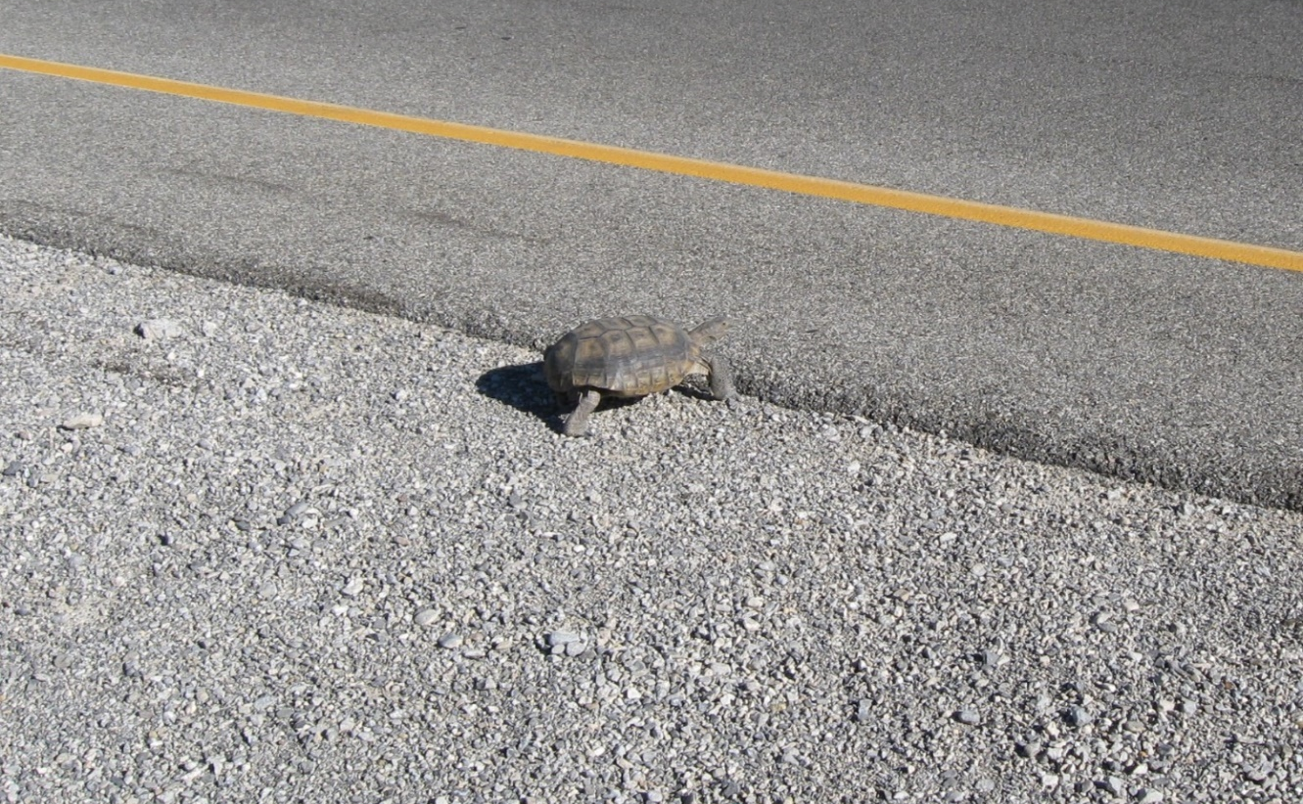
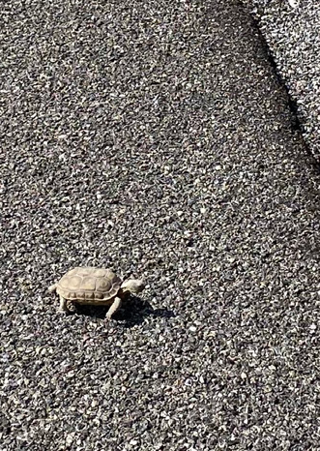
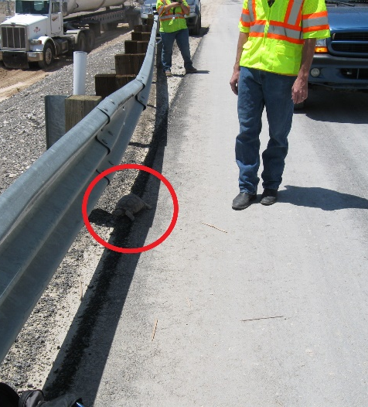
Why is it essential to the desert tortoise?
Construction of barrier fences will prevent vehicle/wildlife collision
Modifications of culverts will re-establish connectivity between tortoise populations, significantly reducing habitat fragmentation
Adult mortalities reduced, resulting in increased breeding and stabilization of tortoise populations along US 93
Notes:
Desert tortoises to not recognize the road surface as a barrier or potentially harmful (vehicle strikes)
The drive to move through their home range is immense. Home ranges can be as much as a square mile.
The drive is from the need to feed and the need to mate. Tortoises are solidary animals.
By building barriers to access of the highways and state routes we increase the safety of the wildlife and motorists.
Crossings also eliminate the concentration of carrion eaters feeding off the carcasses left behind by vehicle strikes which in turn reduces the level of predation on the surrounding populations.

Slide 12
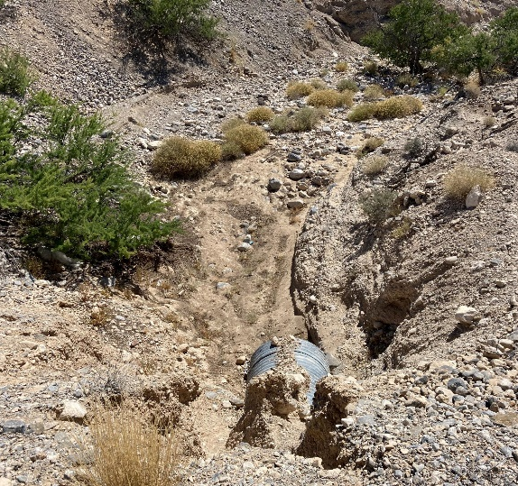
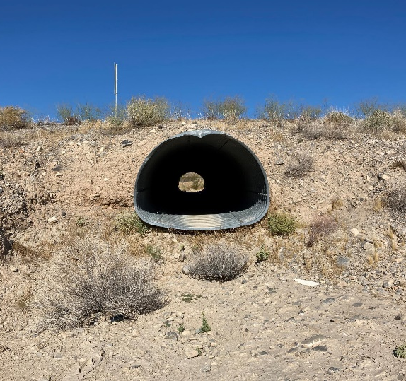
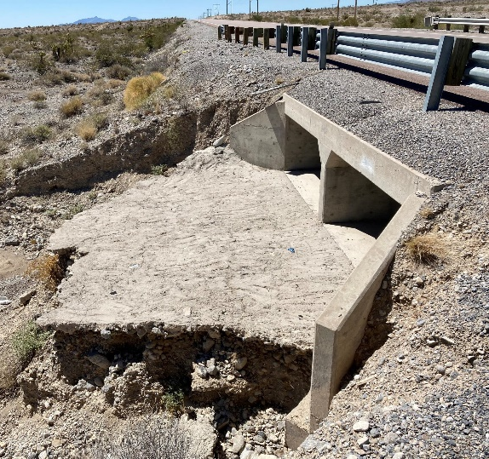
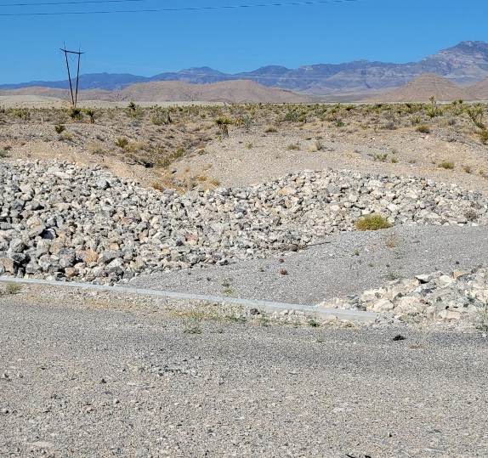
The Challenges
No “one size fits all” design
The hydraulic nature of the region produces significant water flows and erosion
Designing erosion control structures that will also allow the passage of tortoise
Balancing the design between tortoise/wildlife accessibility and public safety
Notes:
Most of the time, hydrology needs and the safe passage of tortoise needs can be easily married together.
However, in some situations, hydraulic design makes it very challenging for design to incorporate the smooth access points for tortoises, eliminate points of entrapment, while still providing a structure that changes turbulent flow to laminar flow.
Turbulent flow = erosion!
Historically, the answer has been ever increasing size of riprap used to armor the flow channels. This is an issue for tortoises since it creates large, irregular shaped voids between the larger rocks that may result in entrapment and death of the tortoise.
The other side of the coin is the funneling of the large amounts of water that rapidly flow through desert washes causes significant head-cutting and erosion, altering the topography and damaging the local plant community structure.
This erosion creates an impassable barrier to tortoises and other wildlife, preventing them from using unmodified culverts. End result, wildlife is forced to range across the surface of our highways.

Slide 13
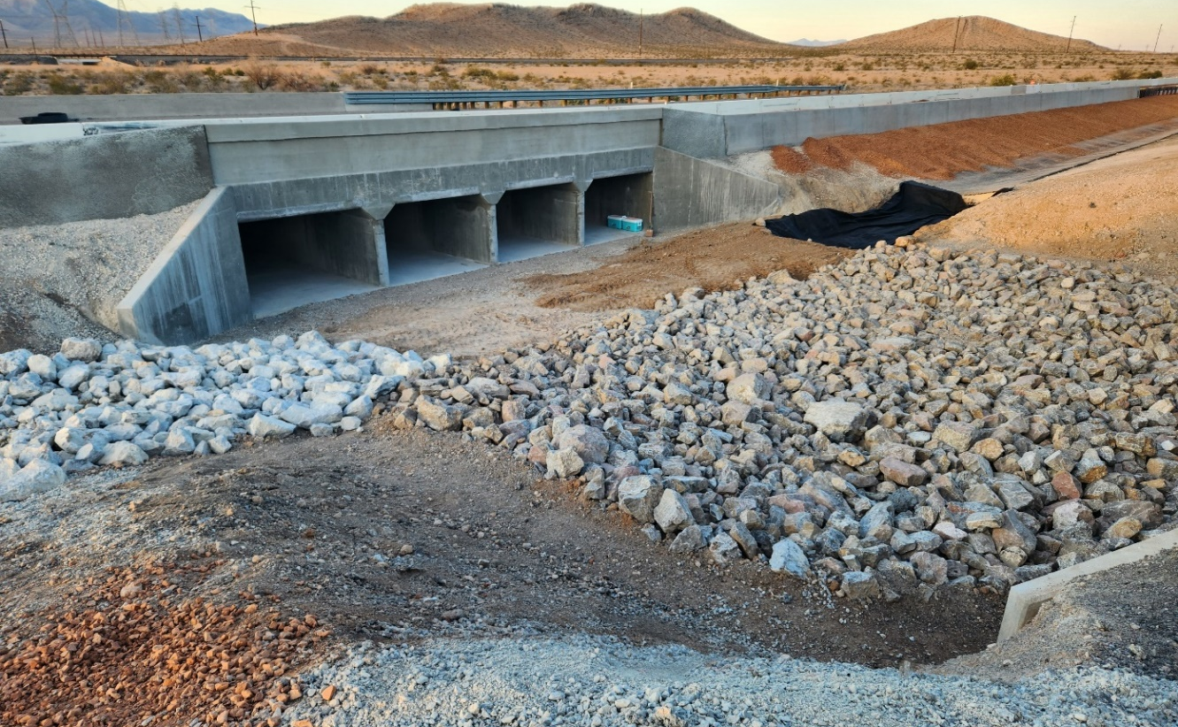
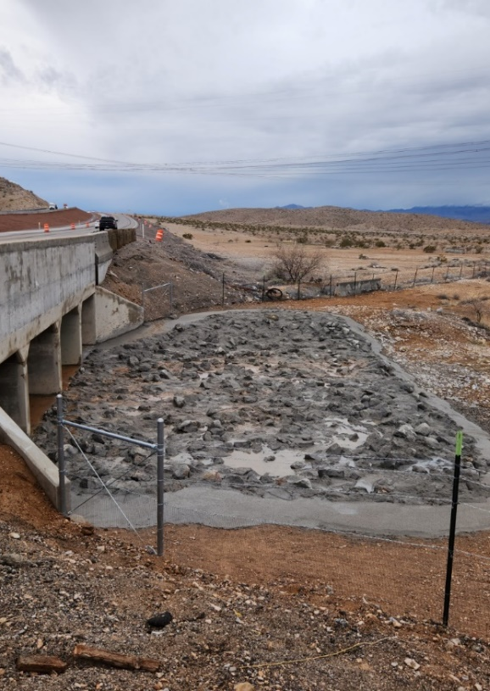
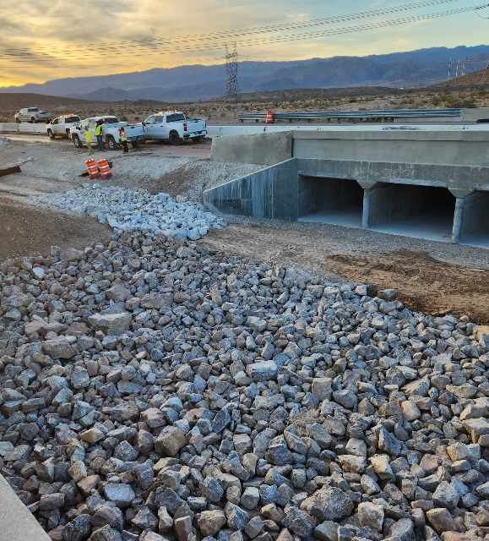
It can be done
Design each structure with flexibility to address each crossing location
The answer to preventing erosion is not “just add more riprap”
Redefine the usage of riprap to armor the washes
Include slurry or concrete grouting
Build to last
Notes:
This is an example of how design, hydraulics, and environmental personnel within NDOT can work together to first design a structure modification that has the greatest potential to meet the needs of the tortoise and the control of water.
Then the contractor gets involved when trying to build the structure and added their insights. The resulting structure provides the best pathing potentially for tortoises and wildlife, coupled together with changing of turbulent flows to laminar flows. Erosion is reduced or significantly eliminated, reducing maintenance costs while providing for the safety of the public. One approach, as was taken here on the I-15 north of Las Vegas, was to use smaller, class 300, riprap and tie in the layers fully with slurry. Then the edges were smoothed to provide a solid and stable 2-foot-wide path for the tortoise that would resist erosion.

Slide 14
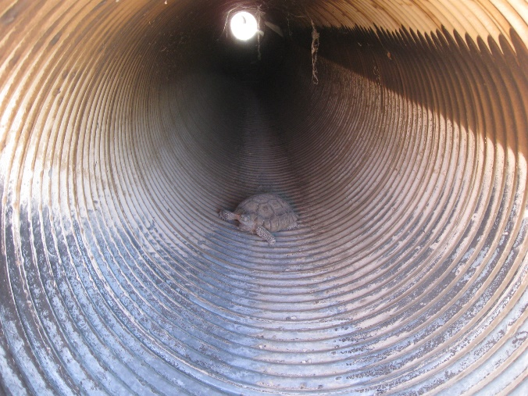
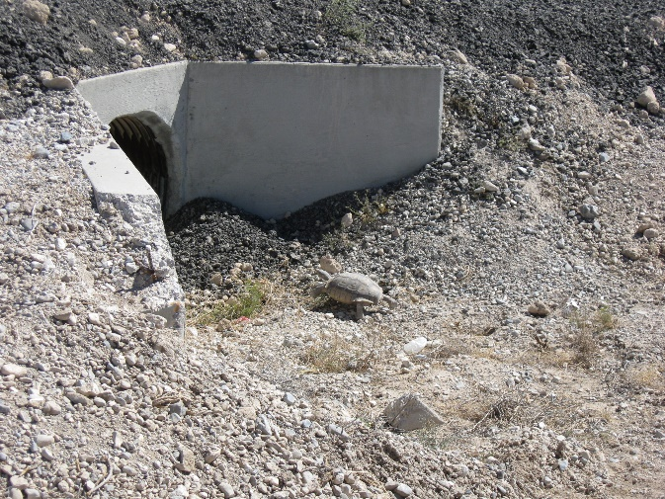
“If you build it, they will come”
Tortoises and other wildlife have been documented using both unmodified and modified culverts
Notes:
Multiple studies have documented the use of culvert by tortoises and other wildlife. BLM and NDOW have cameras set-up in some locations that have photographed numerous examples of tortoises using the structures and following the fence funnels.
Unmodified culverts have also been used but it is far more random and often, tortoises and other wildlife “brave” the open road crossings, even when a culvert was only a few hundred feet away.

Slide 15
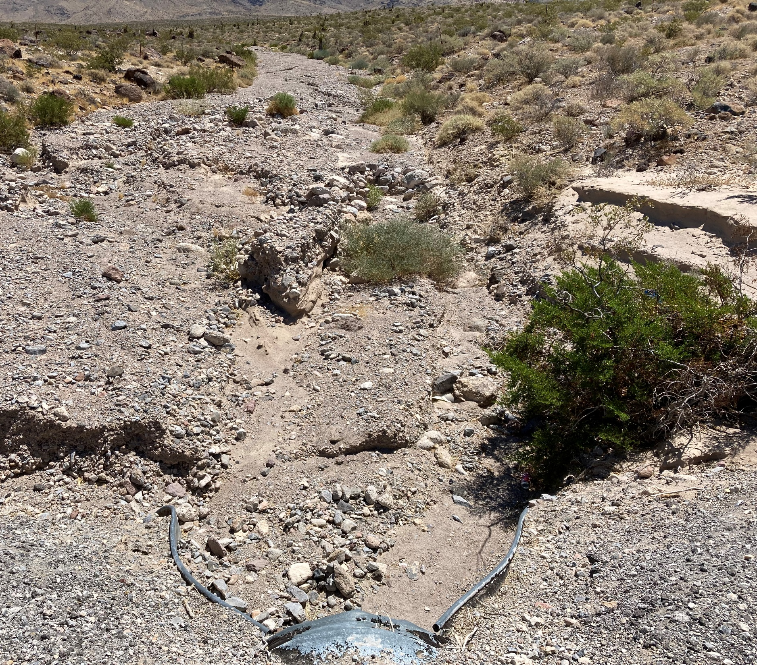
Wildlife Crossings not only reestablish connectivity between populations
Manages and reverses erosion
Resulting in the reduction in non-native and invasive plant species
Stabilizing local ecological communities
Promoting an increase in target plant species for pollinators
Notes:
This is a CMP on US 93 just north of Coyote Springs Investment property.
Conversions of CMPs in high flow areas may reverse the damage caused by the restricting of turbulent flows through culverts.
The use of slurry and grouting maintains the structure, helping to convert turbulent flows to laminar flows.
Culverts can function like a hydraulic monitor.
We’re required to control noxious weeds per NRS and NAC 555. Control of weeds is a great opportunity to improve habitat for our pollinators.
This will reduce the cost and help fight against the noxious weeds.
At the same time, it will put the department in compliance with weed control.

Slide 16
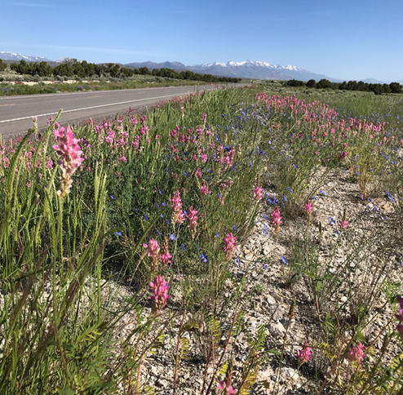
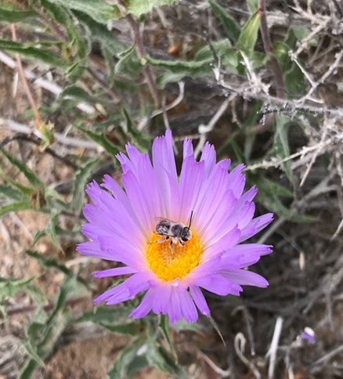
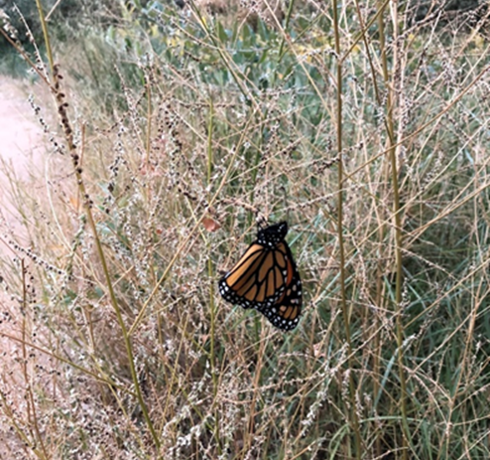
Pollinators in Nevada
Nevada is home to over 800 native bee species.
Roadsides and rights-of-ways have the potential to provide critical habitat for many pollinator species.
Native plants provide a food source for pollinators in the form of pollen and nectar
Ecosystems with native plants tend to have greater biodiversity
Native species are also well adapted to the Nevada climate and can withstand drought and excess heat

Slide 17
Investment In Wildlife Crossings Means
Reduce vehicle damage costs and motorist injuries
More robust structures will decrease future infrastructure maintenance costs and increase highway safety
Decrease wildlife mortality and increase habitat stability
Restoration of wildlife populations
Notes:
While the cost of wildlife crossings may seem prohibitive to some, these structures not only help protect and stabilize our wildlife resources but help prevent magnitudes higher costs associated with property damage and injury to the traveling public, as well as infrastructure maintenance.

Slide 18
Northern Nevada Biology Supervisor Southern Nevada Biology Supervisor
Jozo Vujeva Kristi Holcomb
jvujeva@dot.nv.gov | 775-888-7624 kholcomb@dot.nv.gov | 702-385-6522
Southern Nevada Environmental Scientist
Glen Church
glen.church@dot.nv.gov | 702-385-6552

